Slide 1

Food website
Name : Satya Kumar
Reg No:12203506

Slide 2
INTRODUCTION
A food website is a place on the internet where you can find lots of information about food. It has recipes to try, tips for cooking, and sometimes videos to help you learn. People who like to cook or want to learn more about food can visit this website to get new ideas and share their love for food with others.

Slide 3
Git hub link
https://foodhub975.netlify.app

Slide 4
TECHNOLOGY USED:
FRONTEND : HTML5 ,CSS3,javasScript
Framework : Bootstrap

Slide 5
Navbar section
The navbar is a key component of a food website that helps visitors find their way around. Here’s a simple description of each section:
Home: This is the main page where visitors land when they first come to the website. It usually has a welcome message and a summary of what the site offers.
About Us: This section tells the story of the website or the team behind it. It might include the website’s mission, the people involved, and some background information.
Shop: If the website sells products like kitchen tools, cookbooks, or gourmet ingredients, this is where visitors can browse and buy these items.
Blog: Here, visitors can read articles, recipes, tips, and stories about food. It’s regularly updated with new content to keep visitors coming back.
Contact Us: This part of the website provides information on how to get in touch with the website owners, whether for feedback, questions, or business inquiries.

Slide 6
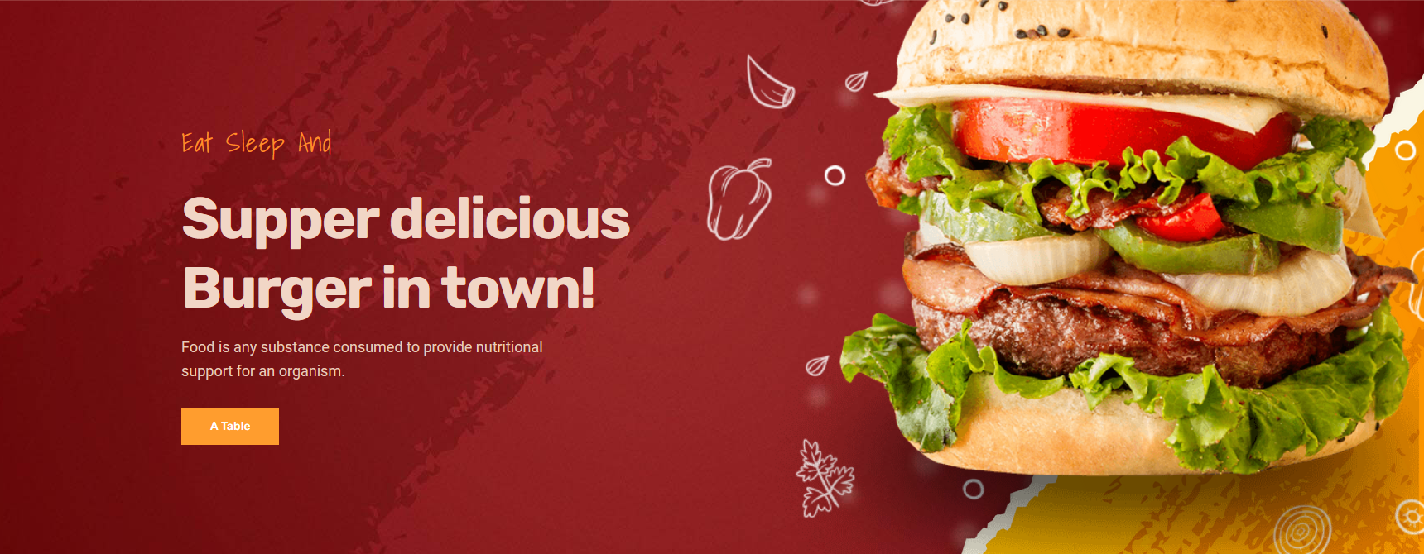
Home page
The homepage of the food website "Foodie" features a captivating hero banner showcasing delicious burgers, with easy navigation to sections like "About Us," "Shop" for food menu, and a blog. The design incorporates a clean header with a logo and a responsive navbar, ensuring a seamless user experience across devices. It also utilizes Google Fonts for typography and preloads essential images for optimal performance.

Slide 7
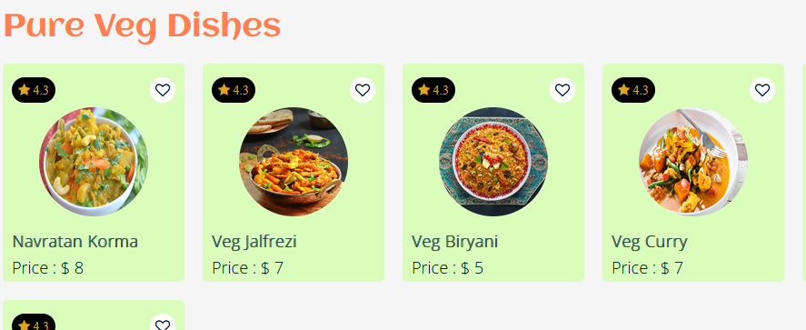
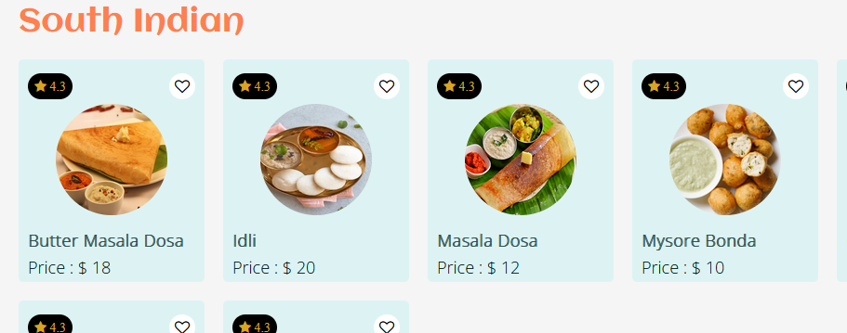
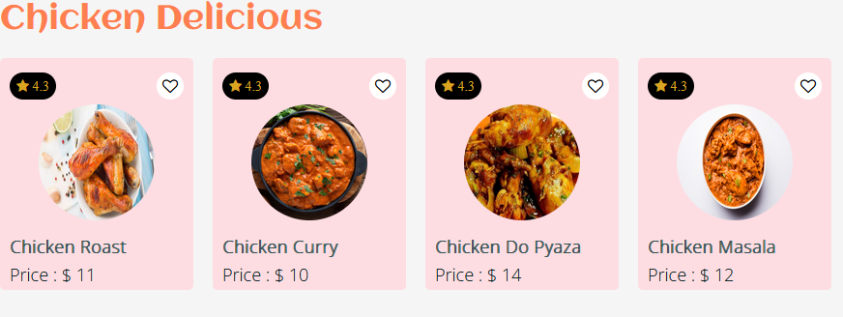
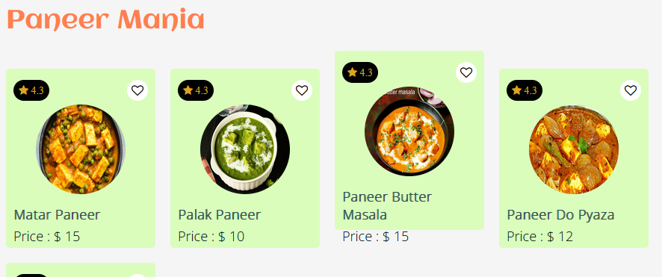
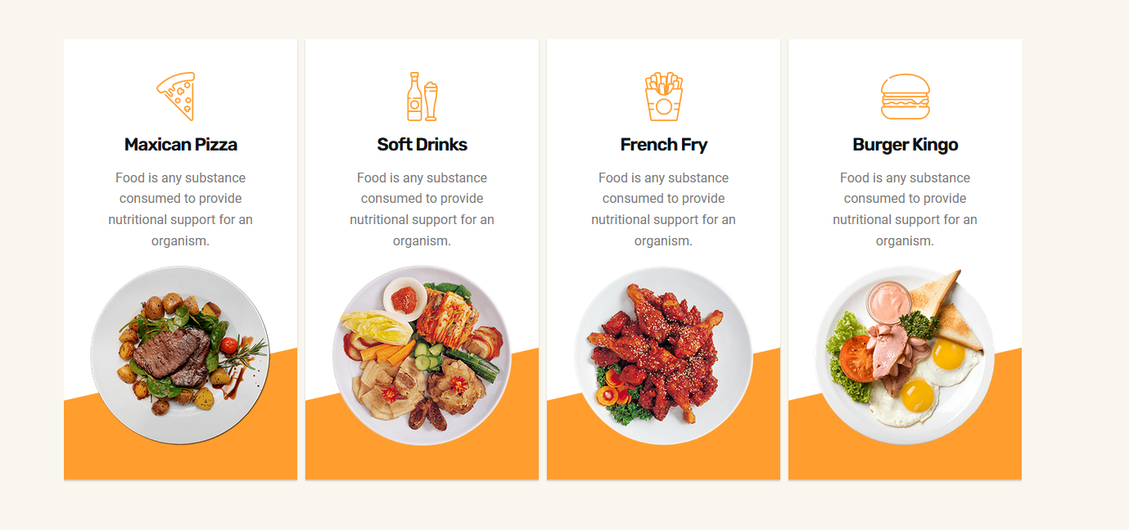
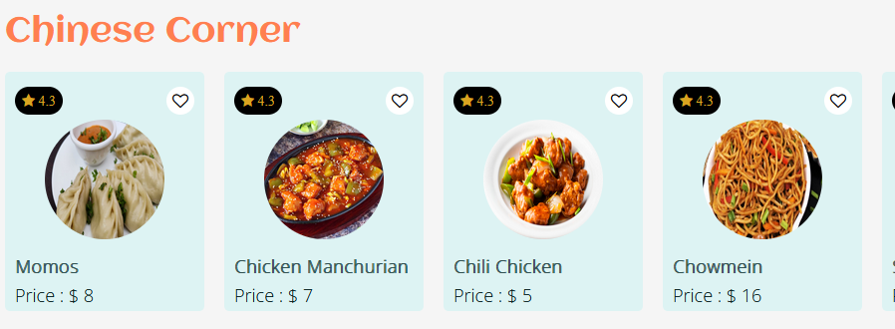
Types of food

Slide 8
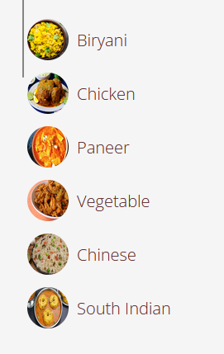
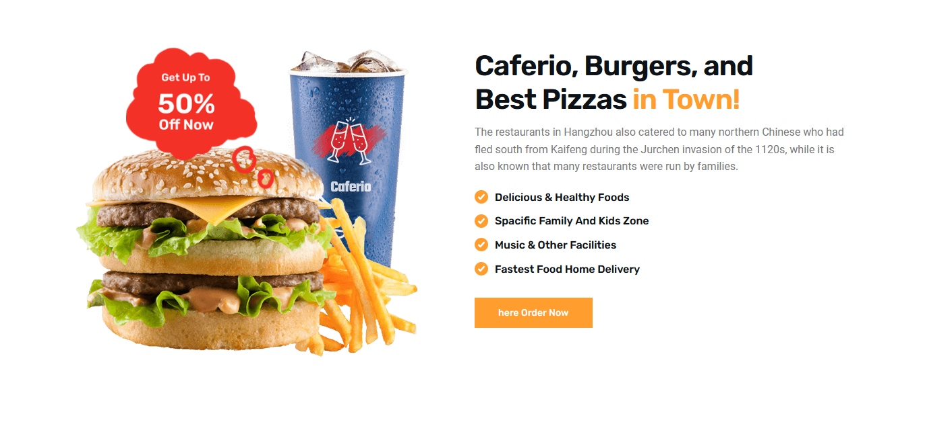
Order section
Here you can order different type of food like Biryani, Chicken, Paneer, Vegetable, Chinese, South Indian

Slide 9
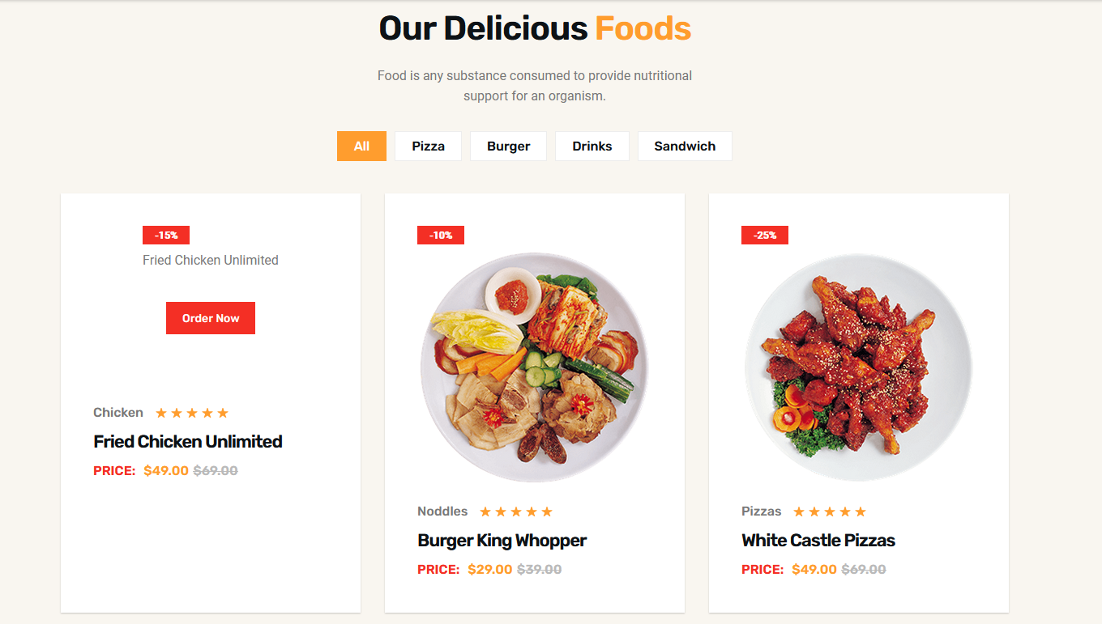
Our Delicious Foods
Food is any substance consumed to provide nutritional support for an organism.

Slide 10
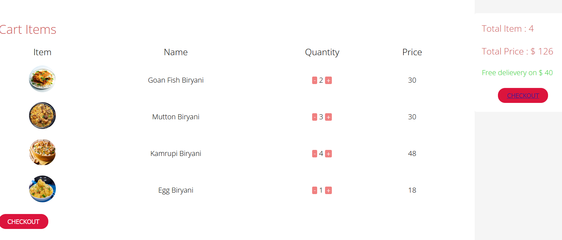
Items selected

Slide 11
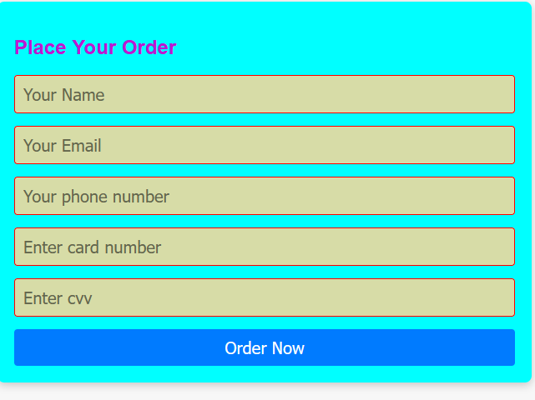
Your order

Slide 12
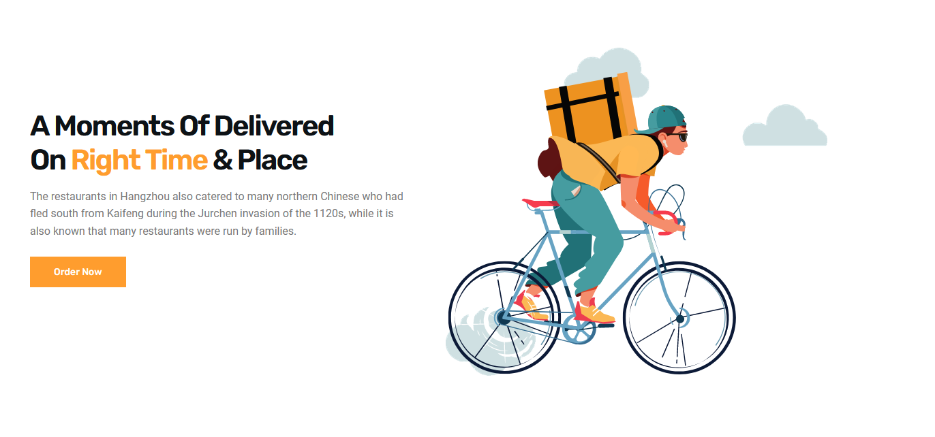
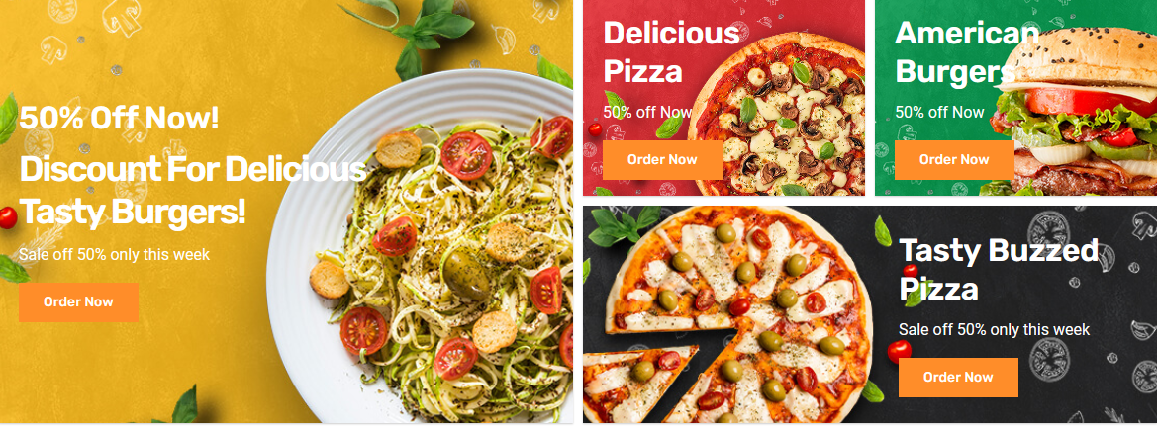
services

Slide 13
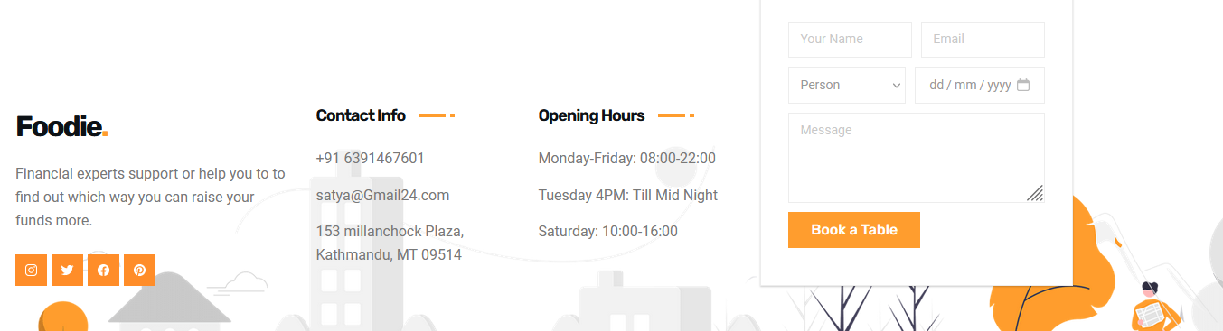
Contact information
The contact information on our website includes essential details for reaching out to us, such as our phone number, email address, and physical location. Additionally, we may provide links to our social media profiles for further engagement. This information ensures seamless communication between our customers and our team, fostering trust and accessibility.

Slide 14

Thank you

